Slide 1

Real Estate and Population Dynamics in the USA
Group 2:
Cameron Cullen
Elena Lomako
Liam ODonovan
Kaelan Purcell

Slide 2
Presentation Focus: Analyzing Population Trends and Residential Real Estate Dynamics
Our project agenda revolves around two key objectives:
1. Population Analysis:
Identify states and counties experiencing the highest and lowest population growth rates. This encompasses factors like the initial population, births, deaths, and migration.
2. Real Estate Assessment:
Compare population growth trends in major geographic regions with the dynamics of the residential real estate market. We will explore factors such as mortgage rates, the availability of homes for sale, and the turnover of residential real estate inventory.
By addressing these objectives, we aim to gain valuable insights into the interplay between population changes and the real estate market in different areas. Specifically we are looking to answer the following questions:
How does population growth impact residential real estate sales?
How does population growth impact residential real estate sale prices?
How does population change impact the rental vacancy rate?
How can the growth rate in average prices and population be used to predict future house prices in the selected states?

Slide 3
Our Data Sources
Census Data: We acquired a CSV file containing information spanning from 2010 to 2020.
FRED National Data: Database for a range of economic data, in our case, rental data across states
Zillow Public Data: Database on residential sales, average sale price, inventory level among others.

Slide 4
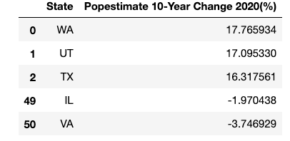
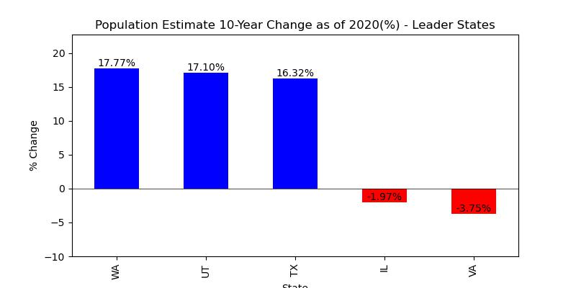
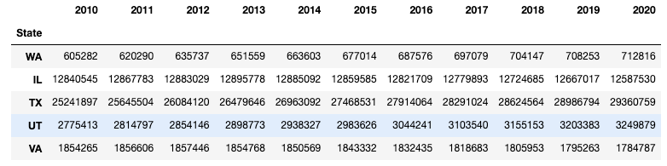
Census Findings
We focused our analysis on states with the highest population growth over a 10-year period, which included Washington, Utah, and Texas, as well as states with the lowest population growth, namely, Illinois and Virginia.
After examining Census population data, we found that Washington (18%), Utah (17%), and Texas (16%) saw the most substantial population growth between 2010 and 2020, while Illinois and Virginia experienced the smallest increases.
We conducted a similar analysis for counties, revealing significant growth in McKenzie County, North Dakota (137% increase), and Loving County, Texas (115% growth) over the same 10-year period. Conversely, Alexander County in Illinois showed a decrease of 33%, and notably, Concho County in Texas experienced a decrease of 31%.

Slide 5
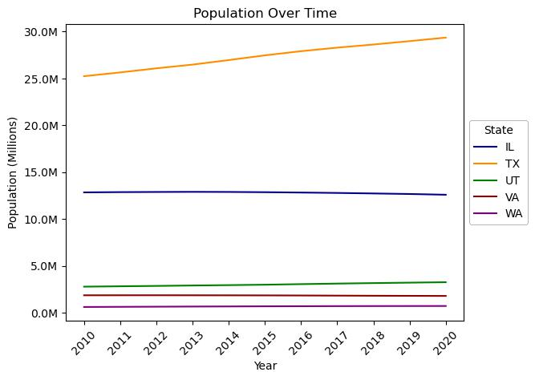
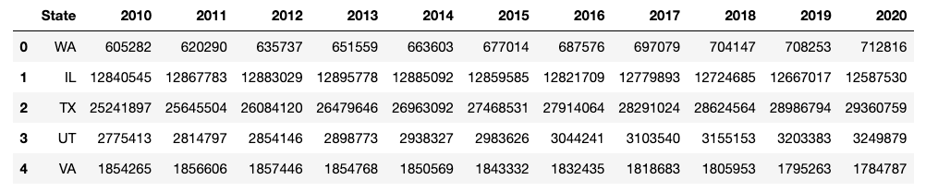
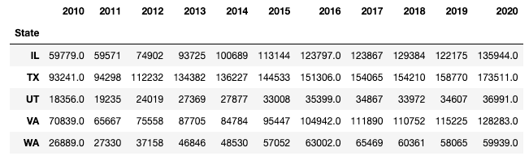
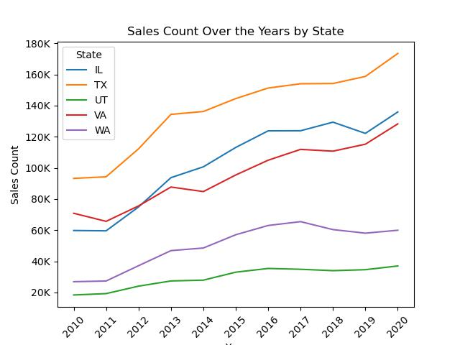
Total Population vs Resi Home Sales
Total Population
Home Sales
Plotting the total population numbers against total residential home sales numbers did not yield significant insights. It is evident that residential sales have increased across all states, and the same can be observed for population.

Slide 6
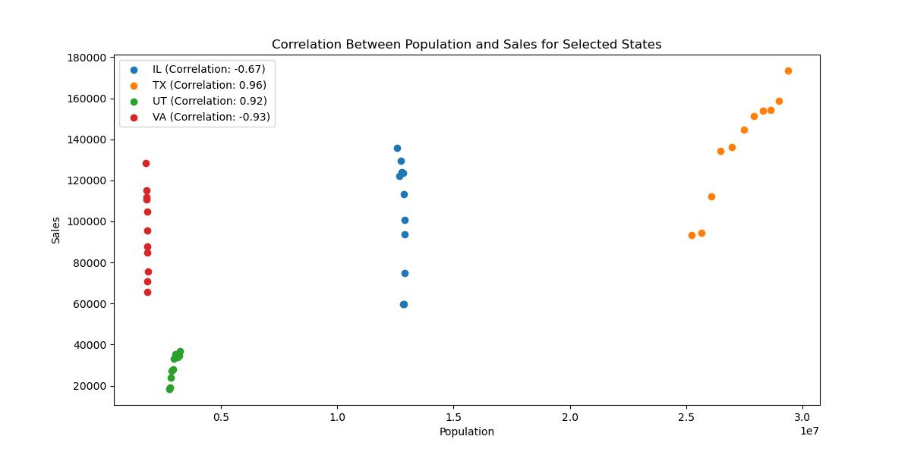
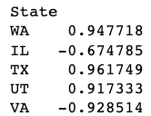
Correlation Insights: Total Population & Residential Home Sales
Washington (WA) and Texas (TX) show a very strong and positive correlation between population and sales, suggesting that as population increases, sales increase significantly.
Utah (UT) exhibits a very strong positive correlation, indicating that population growth is closely tied to higher sales in the state.
Illinois (IL) and Virginia (VA) demonstrate strong negative correlations, implying that as population increases, sales tend to decrease notably in these states.
In summary, population changes exert a significant influence on sales across these states, although the nature and strength of this correlation differ, ranging from positive to negative. These results offer insights into the population-sales dynamics specific to each state. However, it's important to note that these findings do not reveal a common pattern shared by all the states, indicating that regional market dynamics play a crucial role in shaping these relationships.

Slide 7
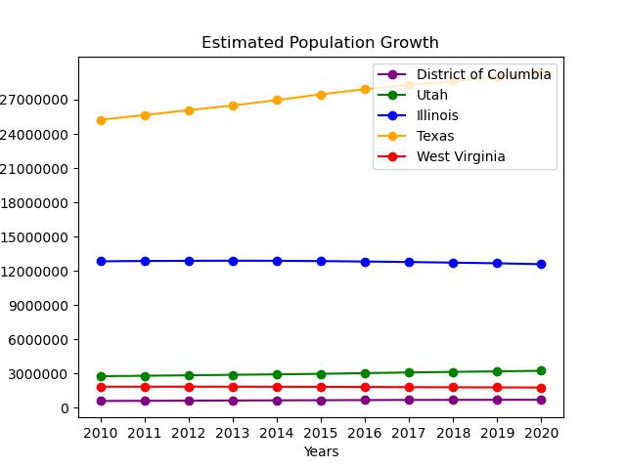
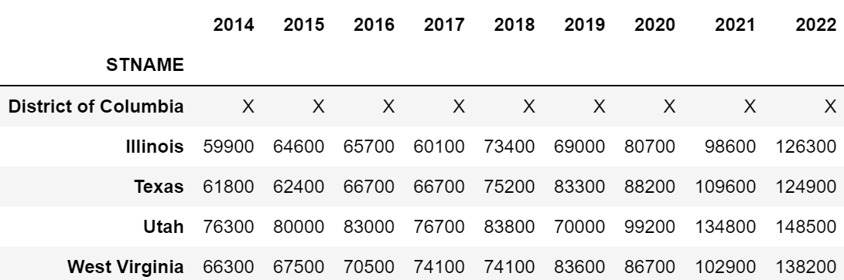
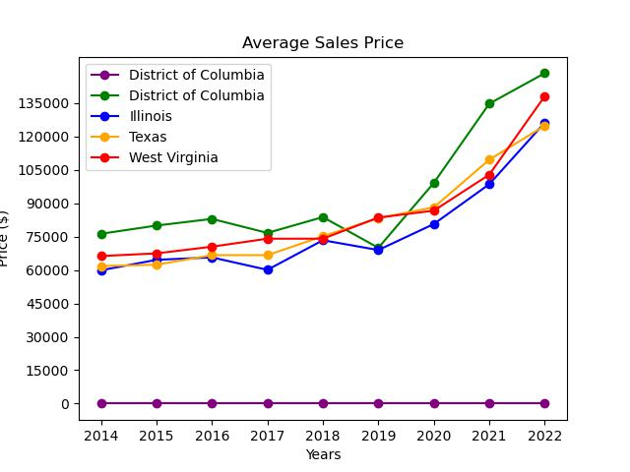
Total Population vs Resi Home Sales Price
Total Population
Home Sales Price
Plotting the total population against total sales price for residential homes did not yield significant results. The only place where population decreased was West Virginia. However, the data does not show that there is a significant relationship between home sales price and population.

Slide 8
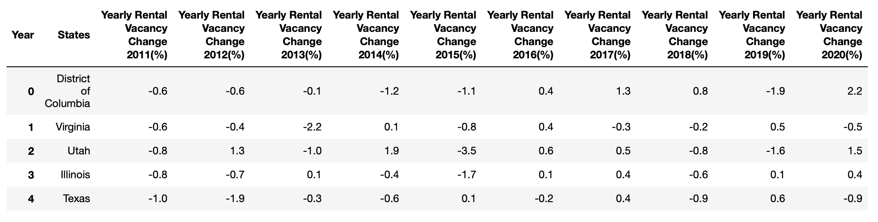
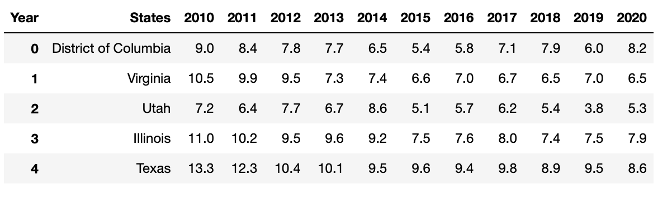
Rental Vacancy Change Overtime
Rental Vacancy From 2011 to 2020
Rental Vacancy Over The 10-Year Period from 2010 to 2020
The tables presented illustrate the rental vacancy rates between 2010 and 2020 and the changes observed during this period. One notable observation from this data is that the rental vacancy rates in DC and UT varied significantly yearly, while the other states demonstrated relatively stable rates throughout the period. Moreover, Texas and Virginia experienced an increase in rental vacancies over the course of these ten years.

Slide 9
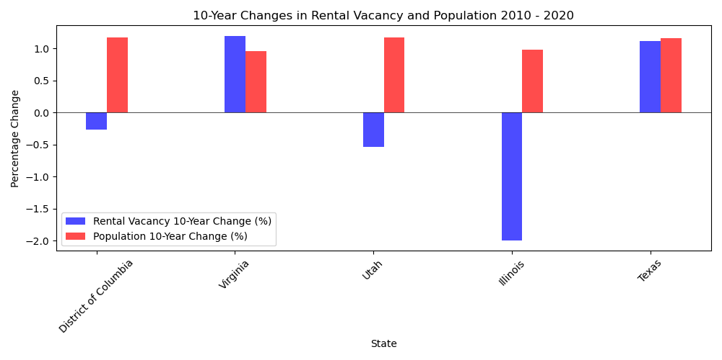
Rental Vacancy vs Population Change
The bar chart displayed on the left illustrates the correlation between rental vacancy and population change. The data reveals that DC, UT, and IL support the hypothesis that rental vacancy decreases when the population increases. The state of Illinois stands out with a significant 2% decrease in rental vacancy over the past ten years.
However, VA and TX tell a different story. It could be due to the fact that people are opting to buy houses instead of renting, or there might have been some developmental projects undertaken in the last decade to cope with the surge in population.
Overall, our analysis shows population change does not impact.

Slide 10
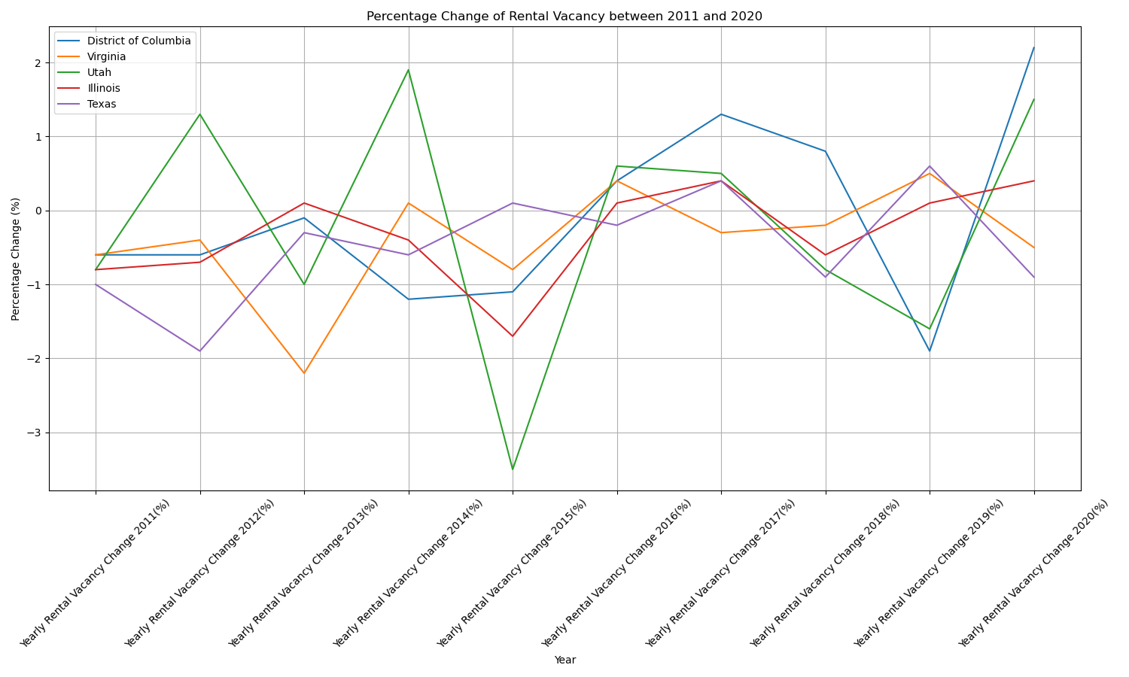
Rental Vacancy vs Population Change

Slide 11
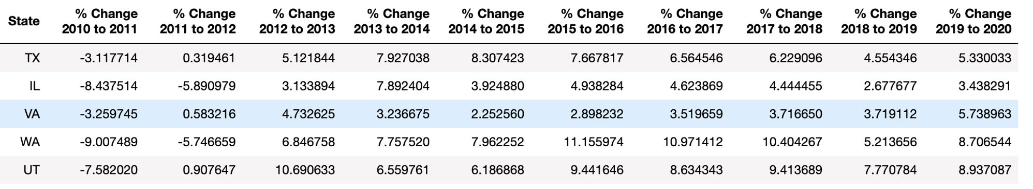
Percent Change in House Values Over Time

Slide 12

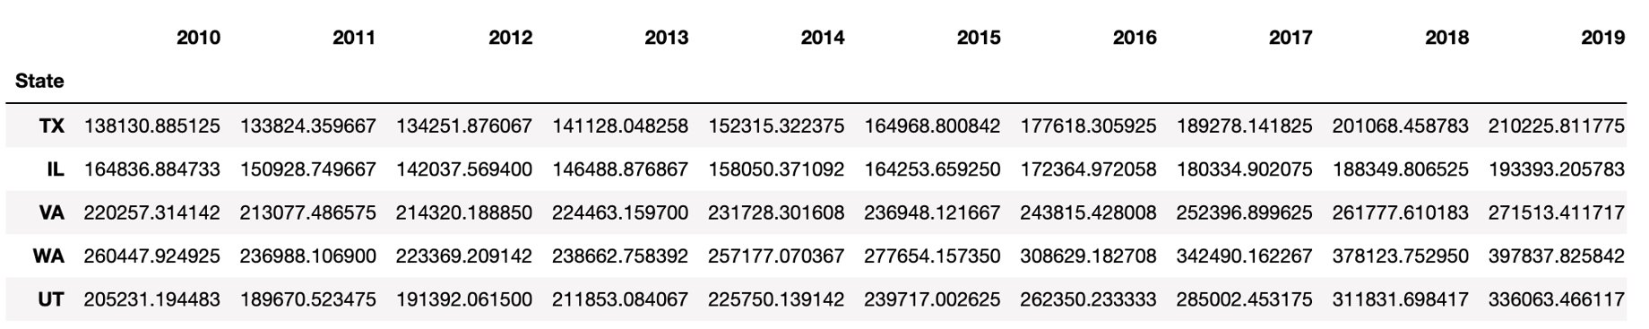
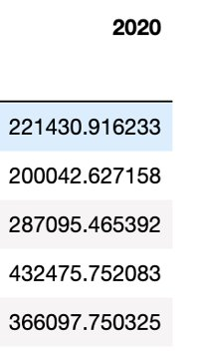


Applications of Analysis
Formula can be used to predict future prices of houses in selected states as the population increases or decreases
= price of house in selected state – base year price of house in selected state = 221,430 – 138,130 = 83,300
= percent population change in selected state - base year percent population change in selected state
/ = x (the predicted change in the price of houses determined by the estimated change in pop
83,300 / 17.765934 = $4688.7487 (for every one percent increase in population the house price increase by that much)

Slide 13
Questions?

